Slide 1


EPILEP SAFE
Team Leader: Aarosh KaraK
Team Members:N/A
Name of the School: Hill Top School
District: East Singhbhum
Category (Junior/Senior): Senior
School Registration No.:1115
Broad Theme of the Idea: Seizure detection watch
JH-SIC 2024 NVCTI, IIT (ISM) DHANBAD

Slide 2
Introduction
The Epilepsy Detection Watch is a cutting-edge wearable device designed to monitor and detect epileptic seizures in real-time, offering a critical tool for individuals with epilepsy. By offering reliable seizure detection and immediate support, the Epilepsy Detection Watch enhances safety, provides peace of mind, and improves the quality of life for those living with epilepsy.
Genesis of the Idea
A few months ago, we experienced an incident in our family where someone had seized for the very first time, and no one around could call an ambulance and take the necessary measures to treat the seizure. While this person was taken care of and did not face any major damage, it made me realise that many people go through similar conditions daily, and people around them are not trained to deal with such situations.
JH-SIC 2024 NVCTI, IIT (ISM) DHANBAD

Slide 3
Objectives
Goals to be Established:
Provide timely intervention to minimize risks and potential injuries during seizures.
Detect seizures in real-time and notify caregivers or emergency contacts immediately.
Allow users to maintain independence and engage in daily activities with confidence.
Offer a sense of security and peace of mind to individuals with epilepsy and their families.
Minimize false alarms and ensure consistent performance.
Allow sharing of health data with medical professionals for better management and monitoring.
Ensure the watch is comfortable, lightweight, and discreet for everyday wear.
JH-SIC 2024 NVCTI, IIT (ISM) DHANBAD

Slide 4
Methodology/Scope of work
Using advanced sensors like accelerometers, gyroscopes, and heart rate monitors to detect abnormal movements and physiological changes.
Using machine learning algorithms to distinguish between seizure activity and normal movements.
Integrating with emergency services to call for help if a severe seizure is detected by using SIM900 GSM/GPRS Module
Sends alerts to caregivers, family members, or emergency contacts via SMS, phone call, or app notification.
Smartphone Compatibility by Syncing with iOS and Android devices for data access and alert notifications by using HC-06 Bluetooth module
Monitoring daily activity levels, sleep patterns, and overall wellness.
Using a OLED or LCD screen for clear visibility of alerts and data.
JH-SIC 2024 NVCTI, IIT (ISM) DHANBAD

Slide 5
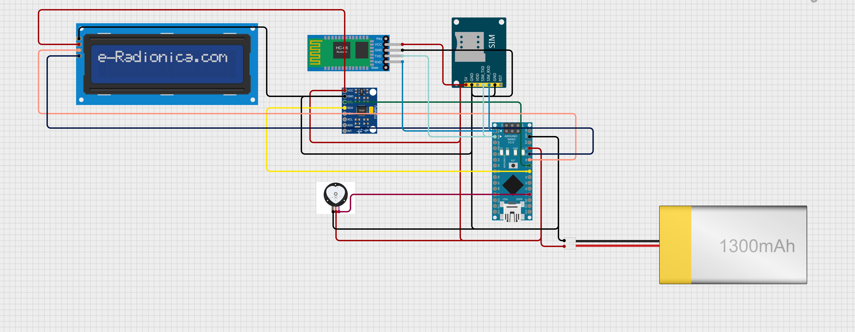
Proof of Concept (PoC)
JH-SIC 2024 NVCTI, IIT (ISM) DHANBAD

Slide 6
Deliverables
Rapid Response: By automatically alerting emergency services, it could significantly reduce the time between onset of symptoms and medical intervention, potentially saving lives and minimizing long-term damage.
24/7 Monitoring: Unlike human observation, the device would provide constant vigilance, particularly beneficial for those living alone or at high risk.
Accuracy: Advanced algorithms could potentially detect subtle changes in vital signs that humans might miss, leading to earlier intervention
Increased Independence: At-risk individuals could maintain more autonomy, knowing they have a safety net.
Reduced Burden on Caregivers: Family members and caregivers could have peace of mind, knowing their loved ones are being monitored.
Timeline of the project
Circuit and Assembling –(4-5 days)
External design –( 7-10 days)
Testing , modifying , rectification (if any) – (2-4 days)
Estimated Budget
CIRCUIT(COMPONENTS) | ENCLOSURE | MISCELLANEOUS EXPENSES
INR 3100 | INR 700 | INR 1000
The estimated budget is calculated to be INR 4,800
JH-SIC 2024 NVCTI, IIT (ISM) DHANBAD

Slide 7
THANK YOU!
JH-SIC 2024 NVCTI, IIT (ISM) DHANBAD

